Slide 1
INICIO
is on a mission to revolutionise elder care in Aotearoa New Zealand
Notes:
Need to add the small HCT to top right hand corner of inicio

Slide 2
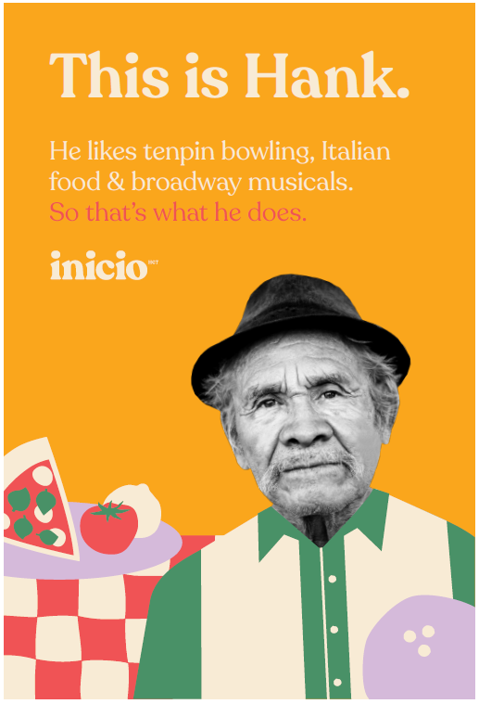
WHO WE ARE AND WHAT WE DO
We are a progressive aged care advisory and solutions organisation accelerating the humanisation of NZ’s elder care industry.
We partner and empower elder care providers and community entities through strategic guidance, innovative solutions, and tailored support helping them raise the bar and achieve a new standard of excellence in their services.
We promote a focus not on what elders need from us, but what they can contribute to their communities and celebrate the inherent worth of each individual.
Together, we create a future where care is rooted in compassion, dignity, and the celebration of life's journey.
We call this; putting humanity first

Slide 3
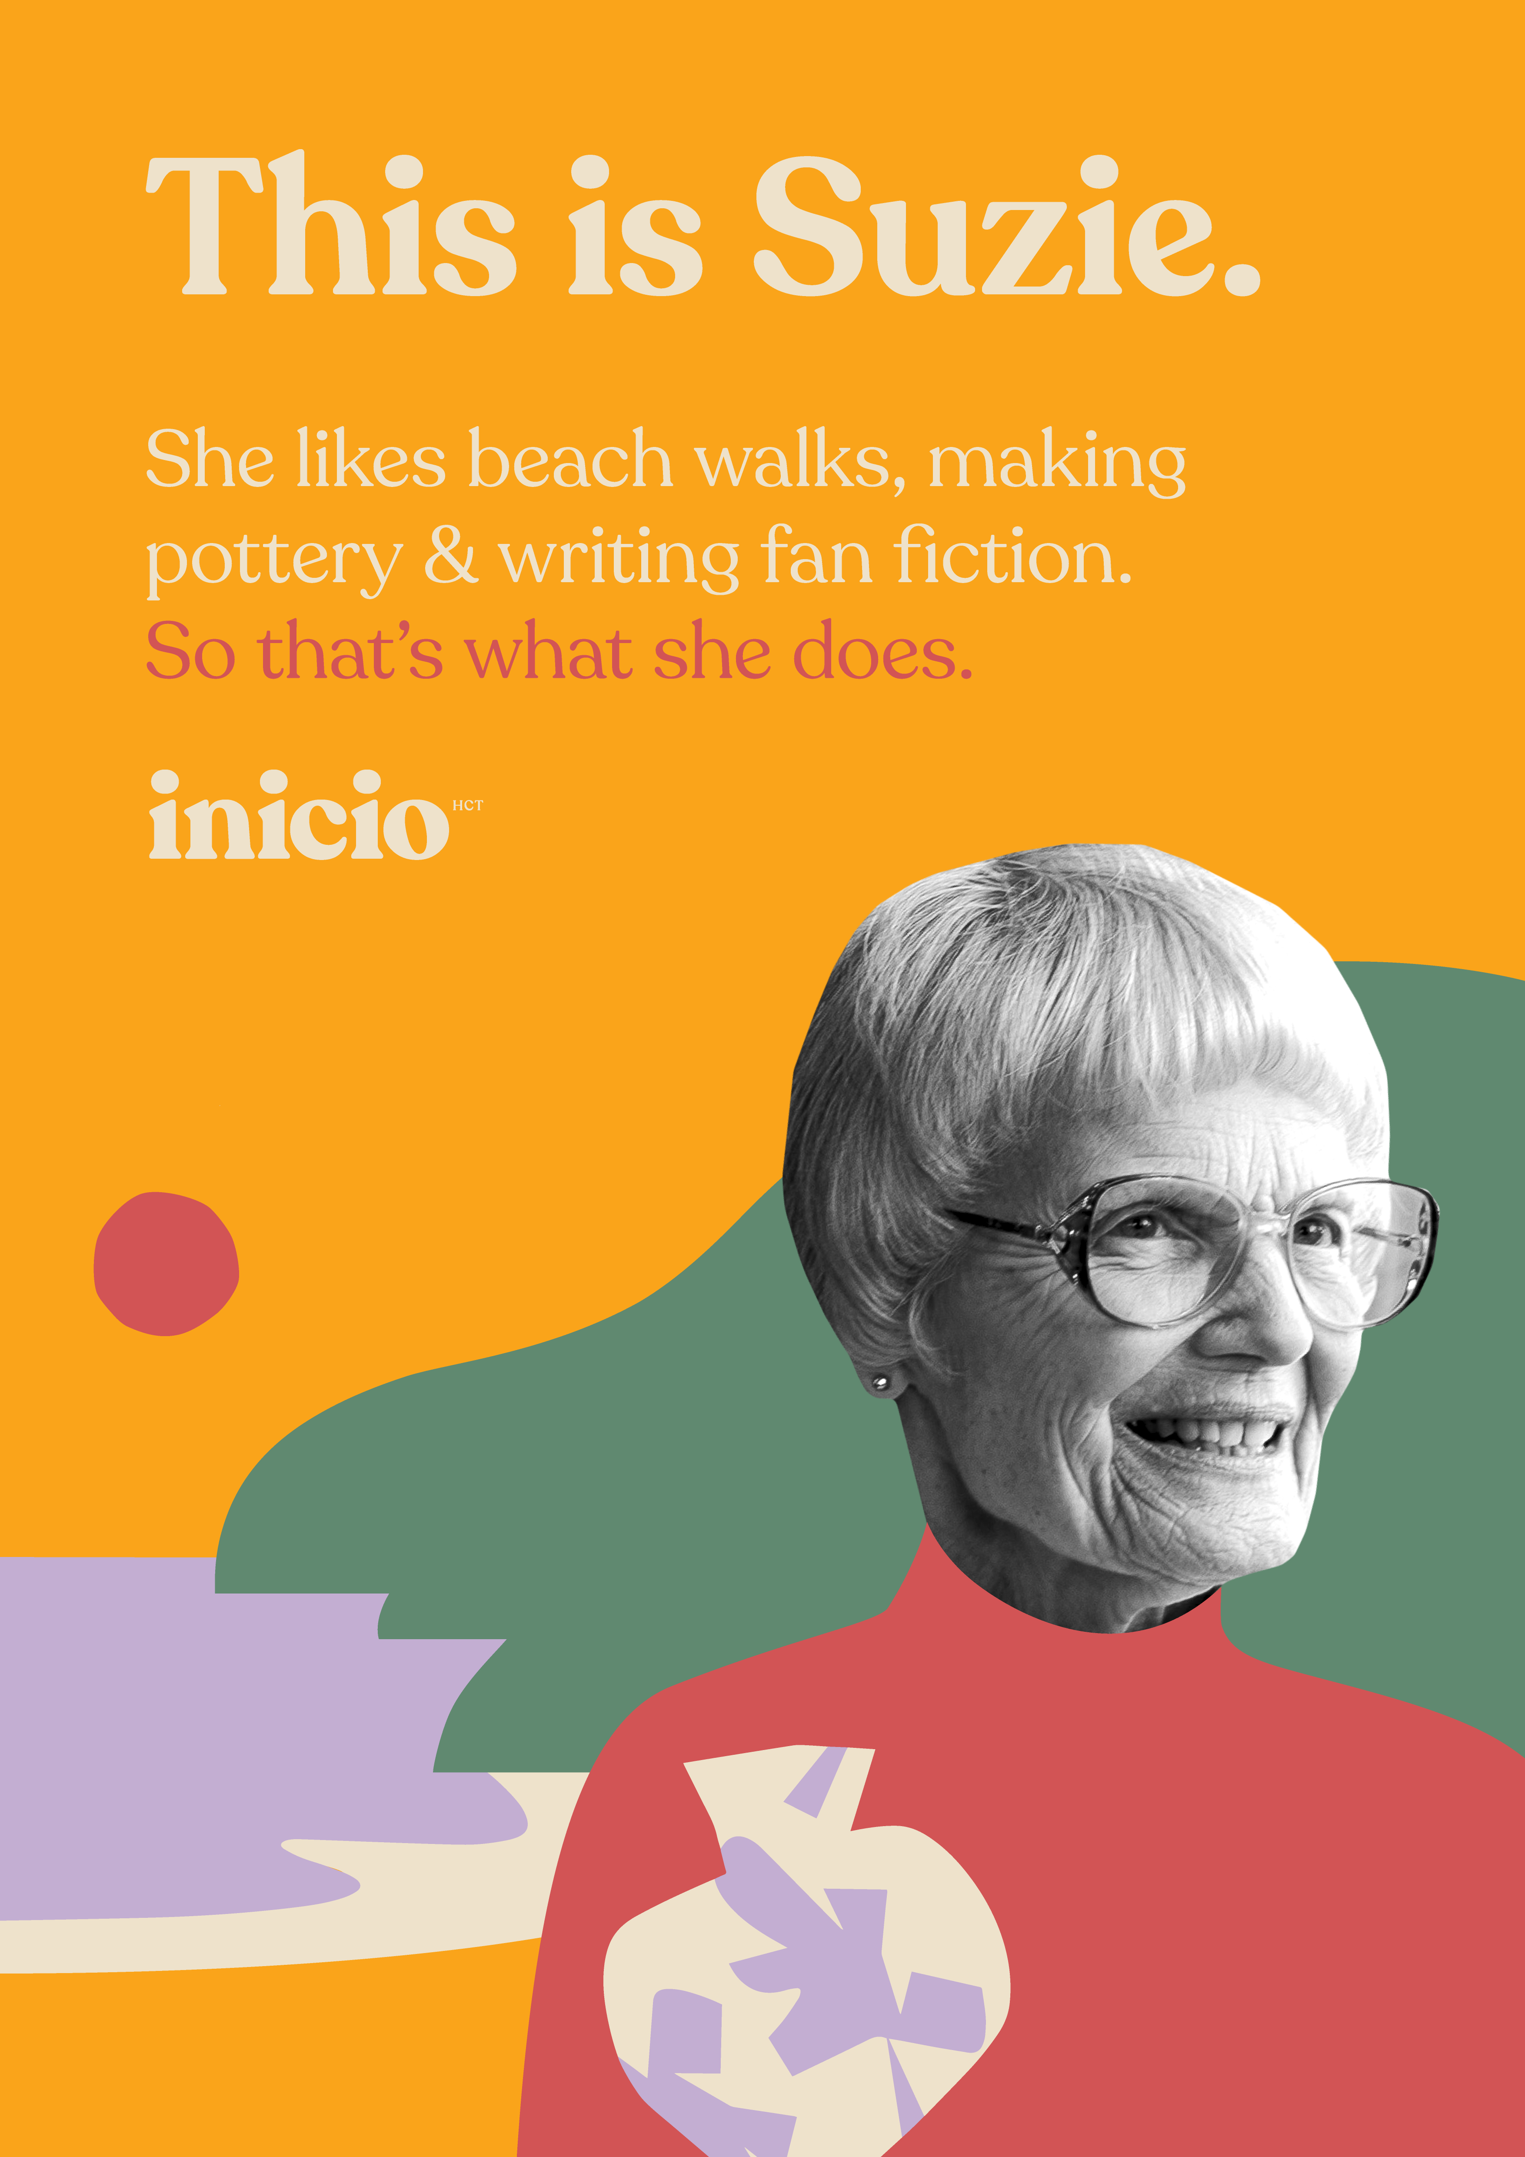
NZ IS NOT PREPARED FOR OUR AGEING POPULATION
By 2034 there will be 1.2 million people aged 65+ in NZ – over a fifth of our total population
Currently 70k New Zealanders are living with dementia. This is expected to rise to 100k by 2030 and 170k by 2050
We have a shortage of care beds and short term rehab beds in Aotearoa NZ
Limited specialist dementia level care beds in NZ
Loneliness is hazardous: 50% of people over 80 report being lonely
“IT'S BEEN SCARY TO SEE HOW LITTLE SUPPORT AND HELP THERE IS FOR FAMILIES. AT TIMES, WE HAD NOWHERE TO TURN AND NO CARE FACILITY WILLING TO TAKE MY DAD, WE WERE ALONE.”
THE PHILLIPS FAMILY.

Slide 4
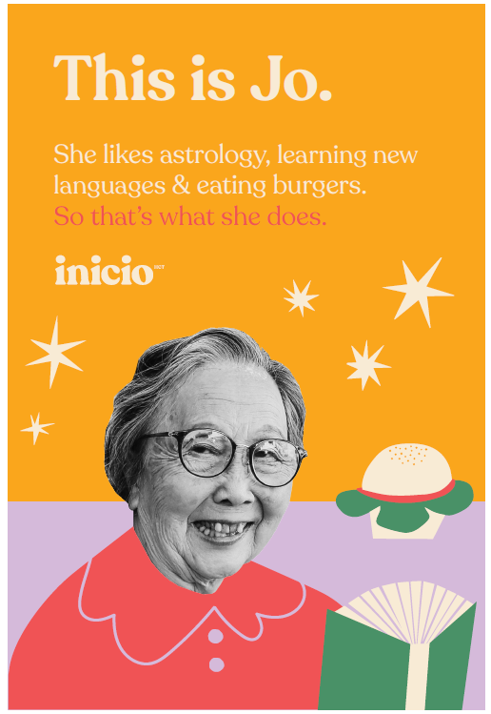
SUPPORTING FAMILIES
The care and services people want and need is evolving. We need to cater for the needs of today and for the future needs of our elders.
We can assist you with navigating the aged residential care industry
We provide education and resources for families caring for family members living with dementia
We connect families with community support services, and agencies
“People with dementia frequently experience being invisible and dehumanised in health and social care settings – and in society more broadly”.
ERIN MCKELLAR ‘A BOX OF MEMORIES’

Slide 5
FAMILY STORY
THE PHILLIPS FAMILY
My father was diagnosed with dementia towards the end of 2022 at the young age of 68. I am an only child in my late twenties with only the support of my partner and mother. The dementia journey with dad has been hard and often distressing. It’s taken a huge emotional toll on us all.
The hardest part has been the lack of support and guidance. We were lost on finding the right care and who to go to get help and a diagnosis. We had no idea how to care for my dad as he declined, and we didn’t understand the disease ourselves. It was scary to see how little support and help there is for families. At times, we had nowhere to turn to and no care facility willing to help us, we were alone.
We reached out to Fiona from Inicio and that is when our journey became a little easier. The team at Inicio have been there for us since we reached out. Connecting via phone calls and emails, guiding us on the right care and expectations and answering all and any questions we have. We are still on our dementia journey with Dad but having Inicio there for support when needed has been invaluable. We are forever thankful and couldn’t have navigated this journey without them.
No one has understood how best to care for my Dad until we found them. I trust them completely and recommend them to anyone who has a loved one with a dementia diagnosis. We hope with the work they are doing they can open a facility of their own one day. There is no one you could trust more in New Zealand to help care for your parent or loved one.

Slide 6
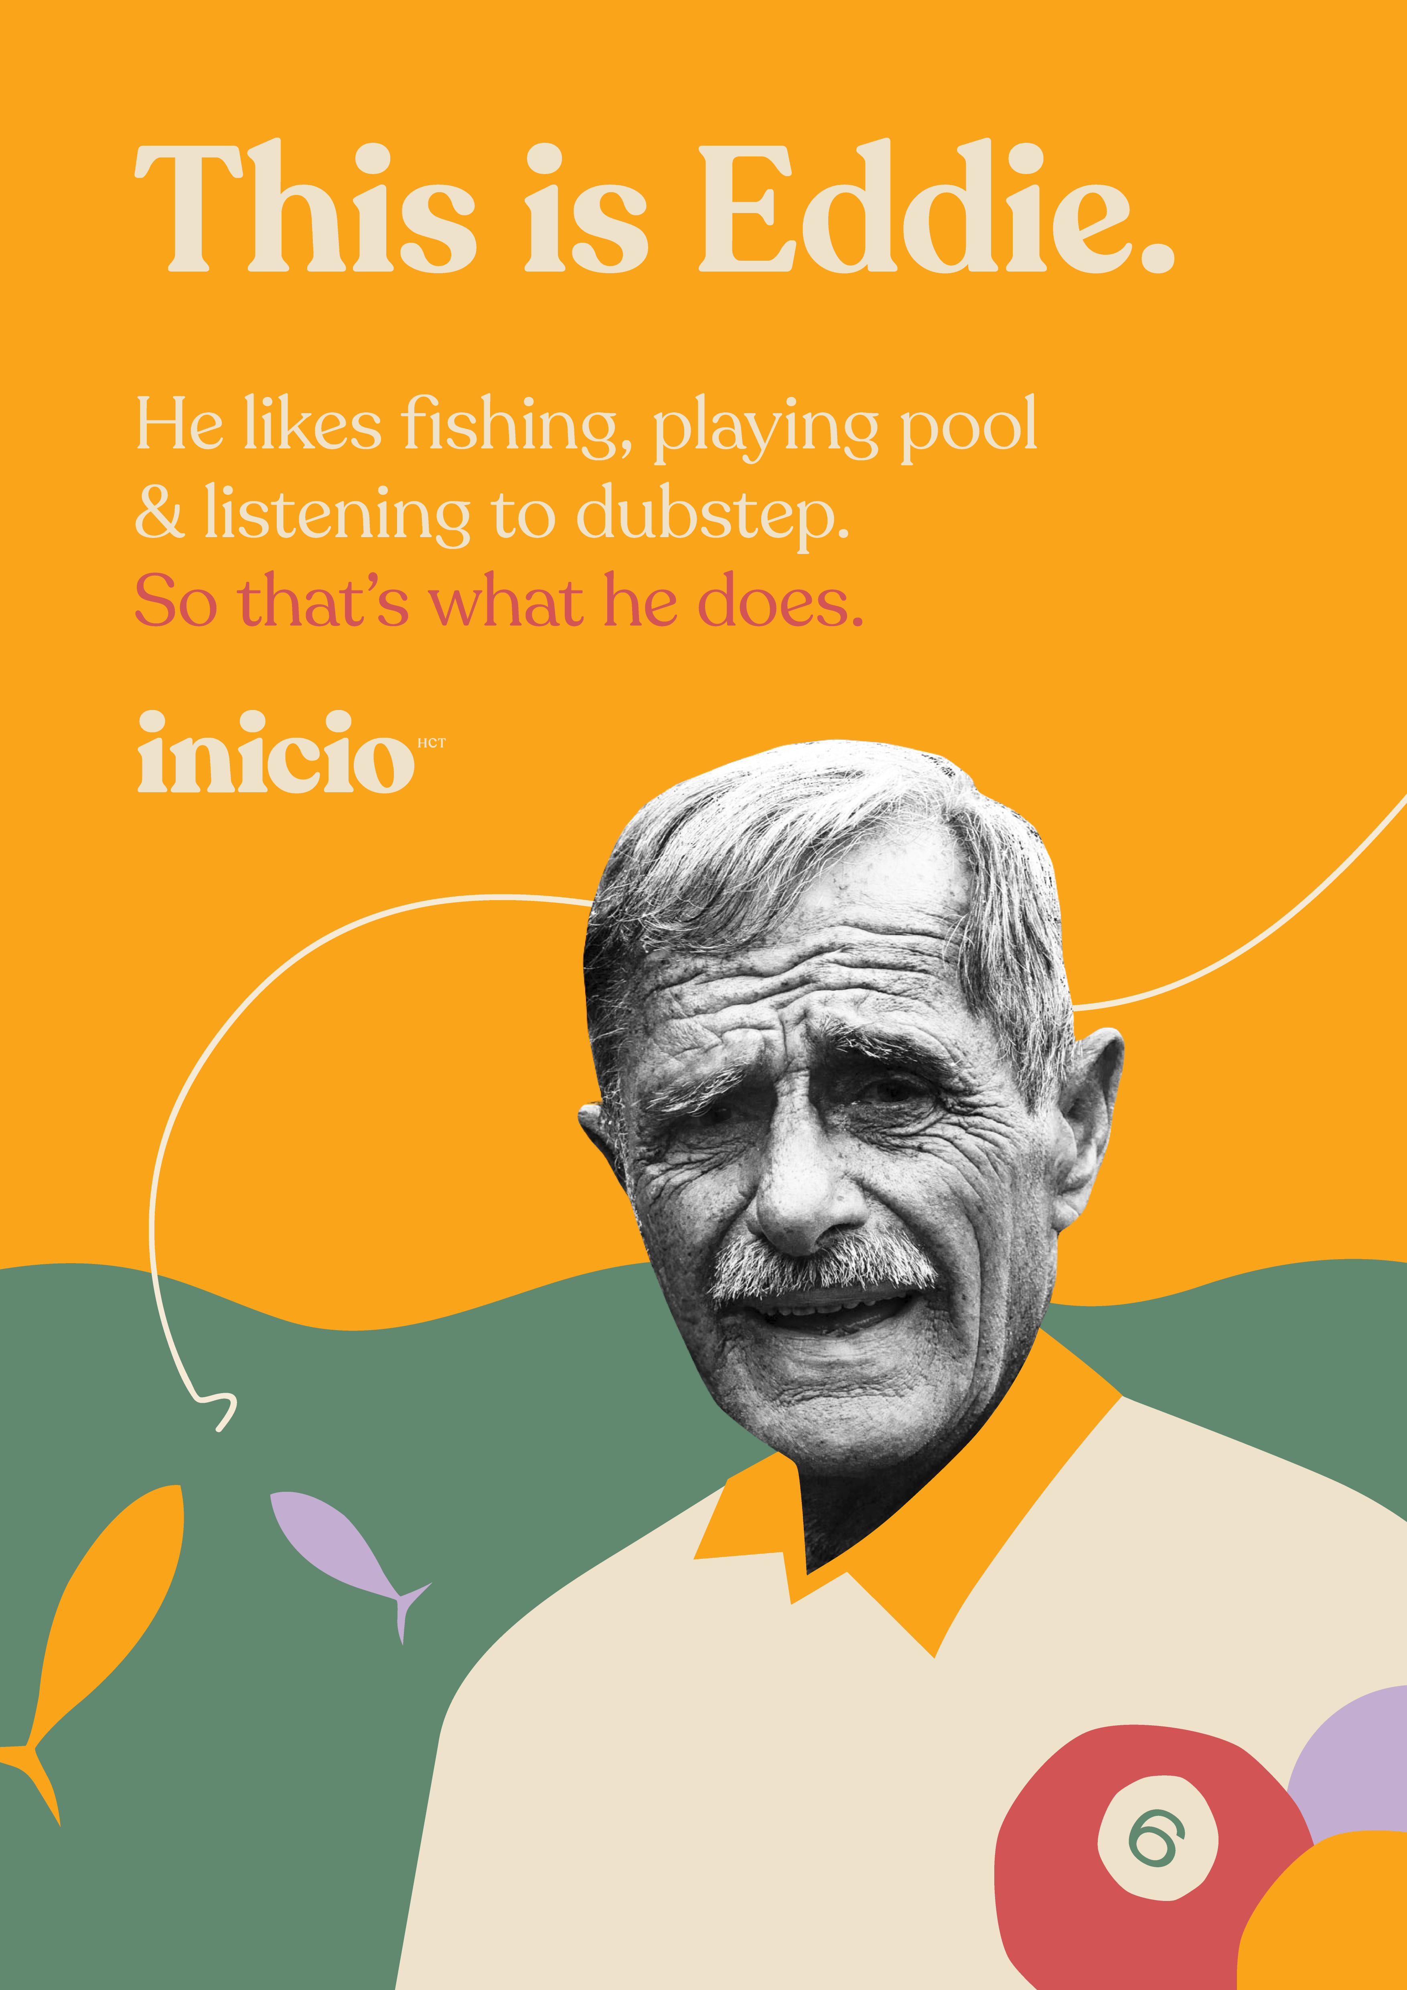
Our Service
Strategic guidance, innovative solutions, and tailored support
Facility management and operational support
Compliance and regulation
Professional supervision
Cultural transformation with a focus on person-directed real home living
Empowered staff and sustainable change
Creating a compassionate and caring safety culture
Dementia advocates and community education
Allied Health Services
Physiotherapy and Occupational Therapy

Slide 7
BUSINESS TESTIMONIAL
CMA Companionship and Morning Activities for Seniors
CMA management worked closely with Inicio on the project and found the various stages and interactions to be of the highest quality and professional standard.
The report produced as the deliverable from the Community Assessment project was very detailed and informative with clear information presentation, options and recommendations. CMA used this report to create our latest Strategic Plan and we are now actively moving ahead with the recommendations from the assessment. It has been instrumental in helping us plan our next steps as an organisation and we are very grateful to Inicio for their work on this project.
I would unreservedly recommend Inicio for their work with CMA. If you require any additional information or have any questions please do not hesitate to contact me
Robyn Walker
General Manager CMA
It is my pleasure to write a letter of endorsement for Inicio Healthcare Charitable Trust.
North Shore Centres of Mutual Aid (CMA) worked closely with Inicio on our Age in Place Community Assessment for Auckland North in 2023. The Inicio team members involved were Ann Coughlan, Helen Delmonte and Fiona Tanis.
We found the team from Inicio to be very professional and knowledgeable about the aged care industry and sector in New Zealand. The assessment had fixed funding and timeframe parameters and Inicio managed very well within these constraints.
The assessment involved a multimethod approach to gain relevant information for the project. The initial work revolved around targeted literature and information scan in NZ and online search and phone interviews with day centres in the region. Inicio were very thorough in this work. The assessment also included organising and facilitating community forums held in multiple locations in Auckland North. The Inicio team ran these sessions very professionally and managed to allow the many participants to have their say very effectively.

Slide 8

OUR VISION
By providing guidance, expertise, and a roadmap for change, we can play a vital role in helping organisations & people shift towards a more humanised approach to elder care, fostering a culture where dignity, compassion, and individuality thrive.
We envision a world where this becomes the common approach, setting the benchmark for excellence in care.
OUR ELDERS DESERVE A PATH TO A FULFILLED LIFE,
NOT JUST END OF LIFE.

Slide 9
INICIO: WHERE WE ARE & AND NEXT STEPS
Working with health industry organisations.
Creating a Culture Change Coalition for Aotearoa NZ.
Engage with innovative healthcare partnerships who see the inherent worth of our elders and have a desire to invest in non-institutional eldercare environments that empower the people working and living there.
We are bringing a wonderful international musical to Auckland – ‘A Box of Memories’ to enhance exposure about dementia and launch our organisation to Aotearoa NZ.
Seeking partnerships for grants and sponsorship.
Open a world class facility based on The Green House® Project model of care
‘A Box of Memories’ is poignant, humorous and insightful musical , highlighting what it means to live with dementia. We will only get better at understanding and working with dementia if we get better at talking and singing about it”
McKellar & McKellar
Follow @aboxofmemories.musical

Slide 10
Ann Coughlan Helen Delmonte Tim White
Trustee RN NZRP Consultant NZROT Trustee
+64 274 497 453 +64 21 281 6 806 +64 215 44500
ann@inicio.co.nz helen@inicio.co.nz tim@inicio.co.nz
Fiona Tanis
Trustee
+64 21 522 151
fiona@inicio.co.nz
inicio.co.nz
Notes:
I Cant line up my NZRP

